Slide 1

Stack Overflow Survey IBM Data Analyst Capstone Project
Thirumurugan Rajasekaran
(12/30/2024)

Slide 2



OUTLINE
Executive Summary
Introduction
Methodology
Results
Visualization – Charts
Dashboard
Discussion
Findings & Implications
Conclusion
Appendix

Slide 3

EXECUTIVE SUMMARY
As part of the research and survey, identified the below :
The most popular , sought after and emerging:
Programming languages
Databases
Integrated Development Environments (IDEs)
Web-frame that are in currently in trend
How is the distribution of the emerging technology based on
Age
Education levels
Countries

Slide 4

INTRODUCTION
This project is to identify emerging and future skill requirements
The latest ‘Stack Overflow’ survey dataset is to be utilized for this project
As a data analyst, the tasks to be carried out during the course of the process are:
- Gathering the necessary data
- Prepare the data
- Analyze the data
- Identify the trends and insights
- Present the results

Slide 5

METHODOLOGY
Gathering the necessary data using python
- Web Scraping
- APIs.
- Request library.
- Data Wrangling
Exploratory data analysis using python
- Analyzing data distribution.
- Handling outliers.
- Correlations.
Data Visualization and Dashboards using IBM Cognos
- Distribution
- Relationships
- Composition
- Comparison

Slide 6
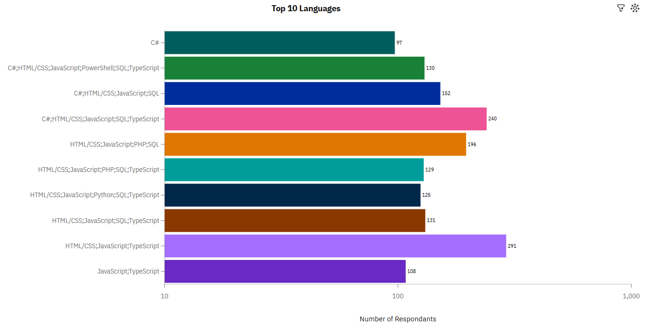
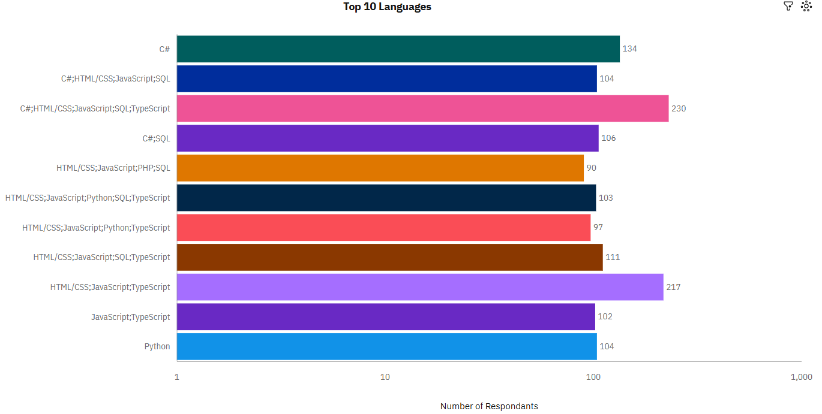
PROGRAMMING LANGUAGE TRENDS
Current Year
Next Year

Slide 7
PROGRAMMING LANGUAGE TRENDS
Findings
JavaScript seems to keep as leading language.
Python fastest-growing.
Great interest in TypeScript
Implications
Possible developers migration from JavaScript to TypeScript.

Slide 8
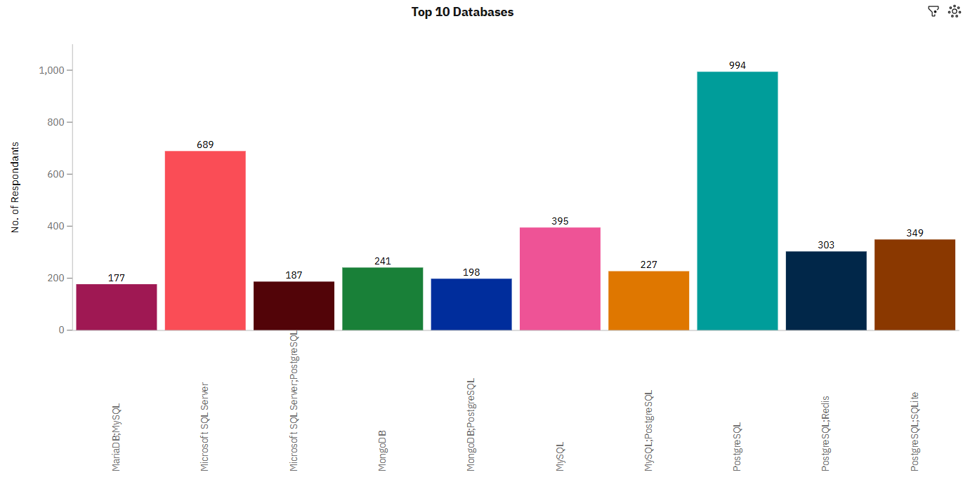
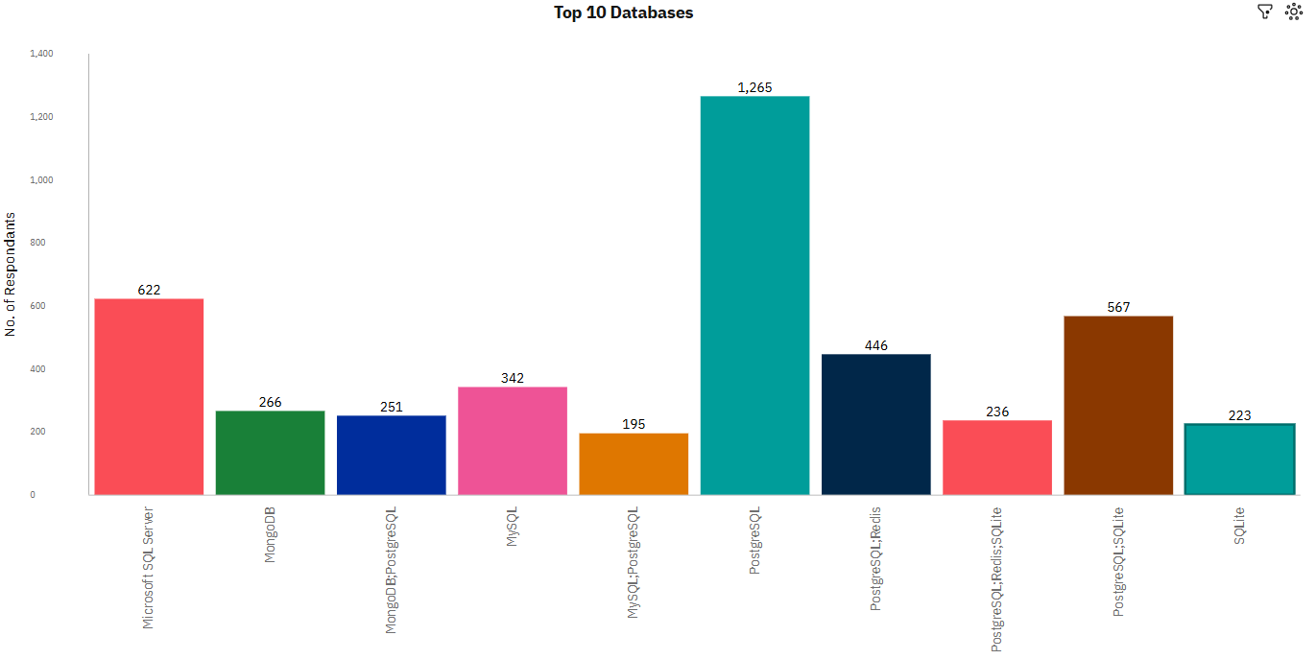
DATABASE TRENDS
Current Year
Next Year

Slide 9
DATABASE TRENDS
Findings
PostgreSQL is most used database and the trend continues the next year as well.
Lack of interest in Microsoft SQL Server and SQLite.
Increasing interest in MongoDB.
Implications
Microsoft SQL Server and SQLite losing ground in the market.
PostgreSQL and MongoDB establishment in the market.

Slide 10

DASHBOARD
https://us1.ca.analytics.ibm.com/bi/?perspective=dashboard&pathRef=.my_folders%2FNew%2Bdashboard%2B-%2BCognos&action=view&mode=dashboard

Slide 11
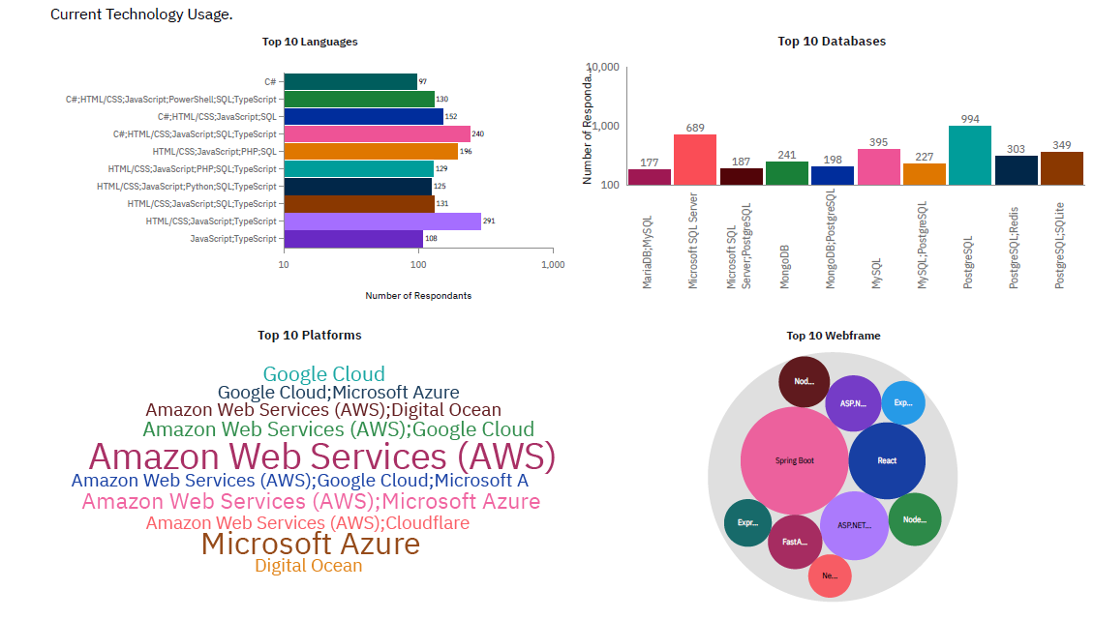
CURRENT TECHNOLOGY USAGE

Slide 12
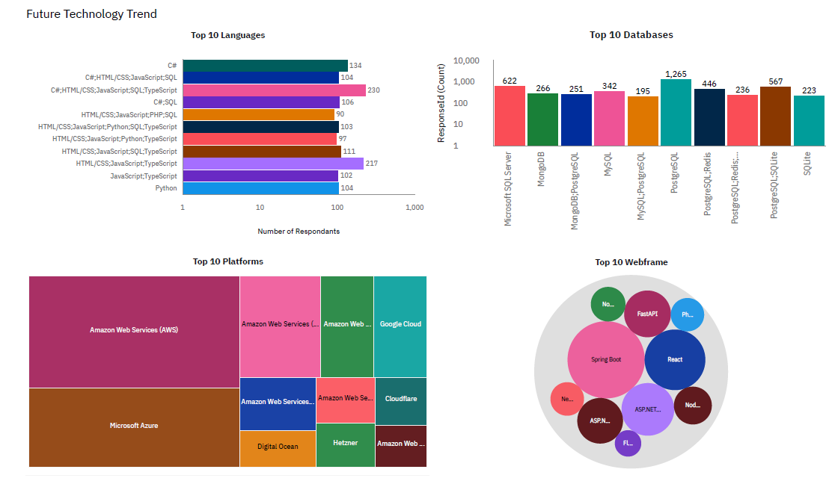
FUTURE TECHNOLOGY TREND

Slide 13
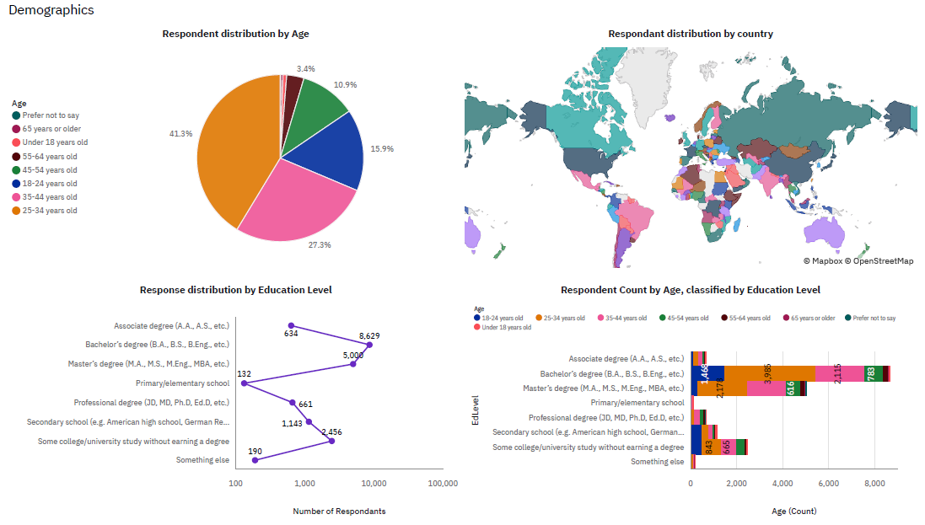
DEMOGRAPHICS

Slide 14
DISCUSSION

Slide 15
OVERALL FINDINGS & IMPLICATIONS
Findings
•JavaScript widely used and TypeScript getting popular.
•Over 40% are between the age of 25-34.
•Developers mostly located in developed countries.
Implications
•JavaScript and TypeScript web frames gaining followers.
•Global polarization of developers location and age
•Young developers without postgrad studies on its majority.

Slide 16

CONCLUSION
Developers are people with very marked characteristics.
A good idea of popularity trends of different tools, platforms and languages can be obtained.
There is a job to be done to spread accessibility of this labor market to countries in development.

Slide 17

APPENDIX
Include any relevant additional charts, or tables that you may have created during the analysis phase.

Slide 18
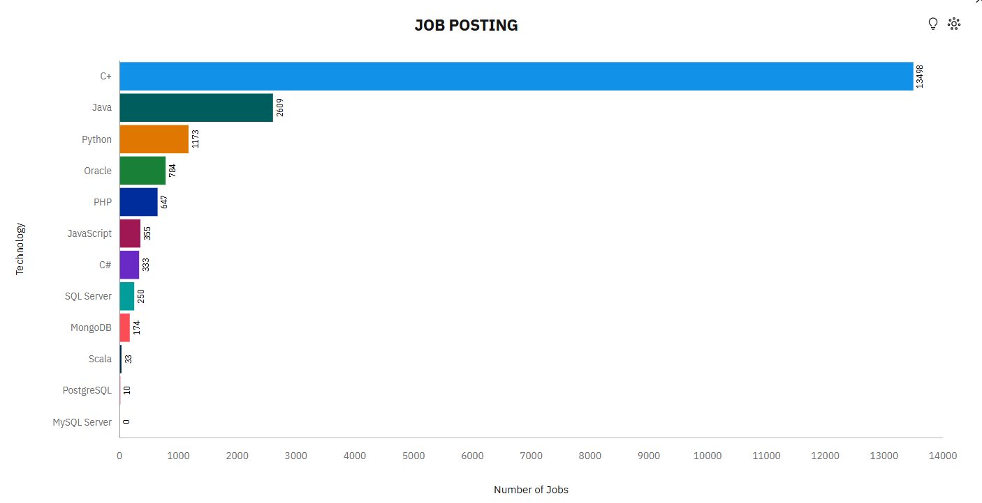
JOB POSTINGS

Slide 19
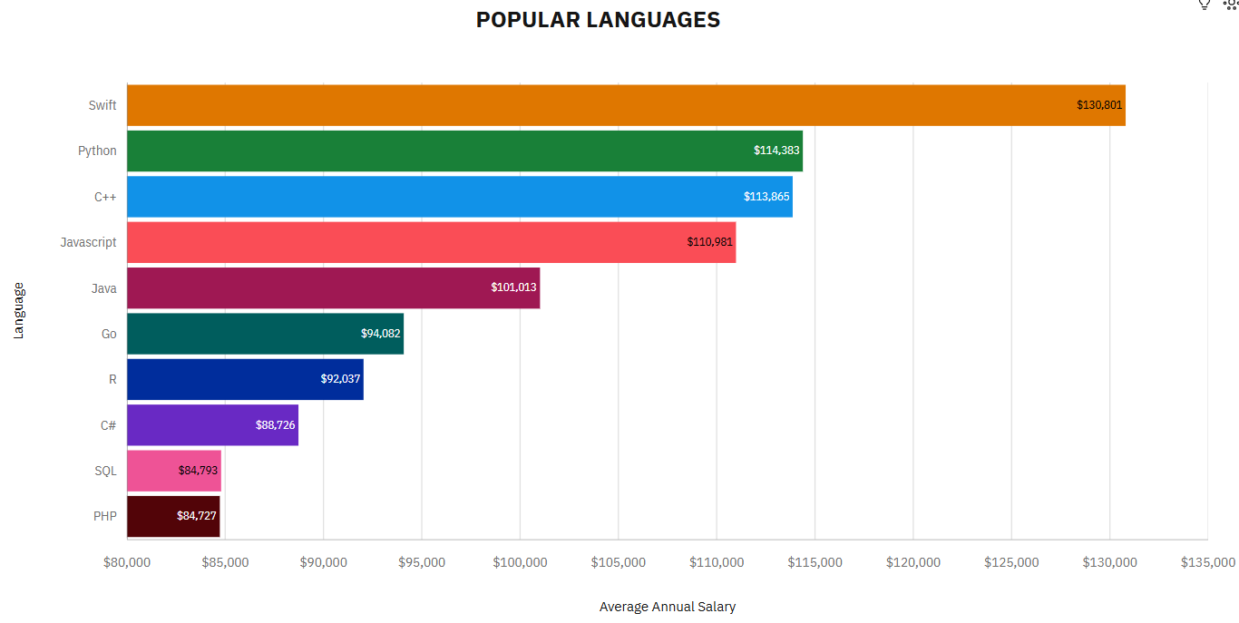
POPULAR LANGUAGES

